Slide 1
Gender Recognition by Voice and Speech
Identifying the Gender of a Voice using Machine Learning
Capstone-2
Sristi Sharma
Springboard Data Science Career Track

Slide 2
Introduction
With increasing application of machine learning in nearly all day to day usability, voice analysis using ML is inevitably one of the most required one. Voice based security systems, recommendation systems, voice based devices are only a few straight use cases. Therefore, I am trying to design a model which can identify the important acoustic properties for a voice clip. Using the model, I should be able to predict and classify the voice to two genders i.e. male or female.

Slide 3
Data
The data set consists of 3168 samples, generated on different acoustic properties of voice. All samples are mapped to the gender of the voice and equally distributed for both the genders ‘male’ and ‘female’.
The following are few acoustic properties of voice which are measured:
meanfreq: mean frequency
sd: standard deviation of frequency
median: median frequency
Q25: first quantile
Q75: third quantile
IQR: interquantile range
skew: skewness
kurt: kurtosis
sp.ent: spectral entropy
sfm: spectral flatness
mode: mode frequency
centroid: frequency centroid

Slide 4
Data Exploration
. Density Plots
. Heatmaps
. Pair plots
Density plots: To see how column values are differentiating male and female.
Heatmaps: To see the correlation among all the columns.
Pair Plots: Created on highly correlated variable with the column ‘gender’.

Slide 5
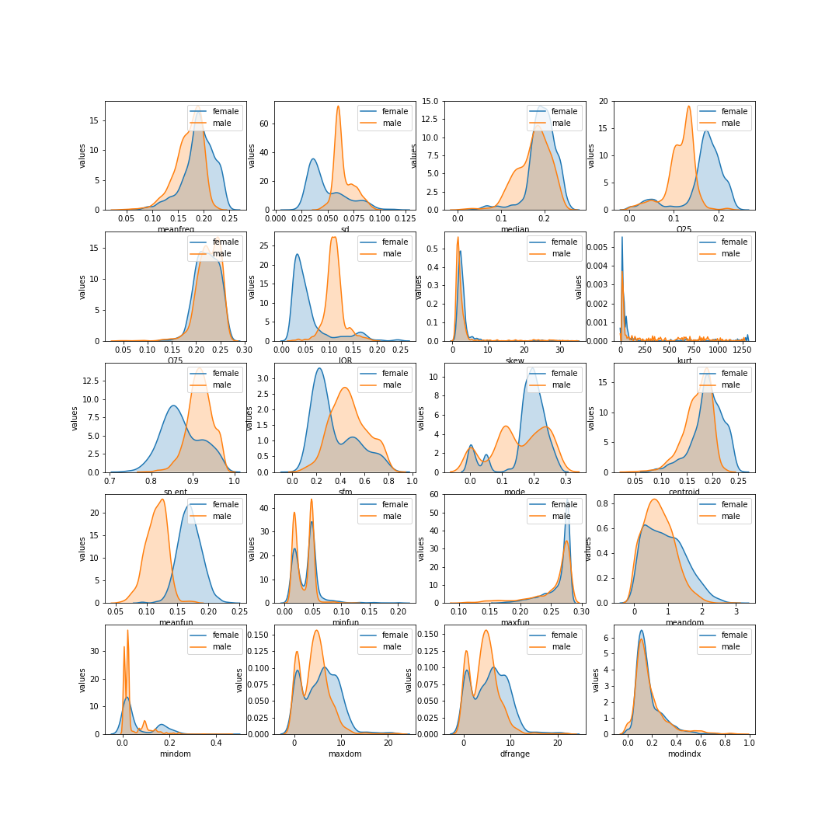
Data Exploration
Density Plots
Columns as ‘IQR’, ‘Q25’, ‘meanfun’, ‘sd’, ‘sp.ent’ are fairly differentiating male and female for the column ‘gender’.
Density plots

Slide 6
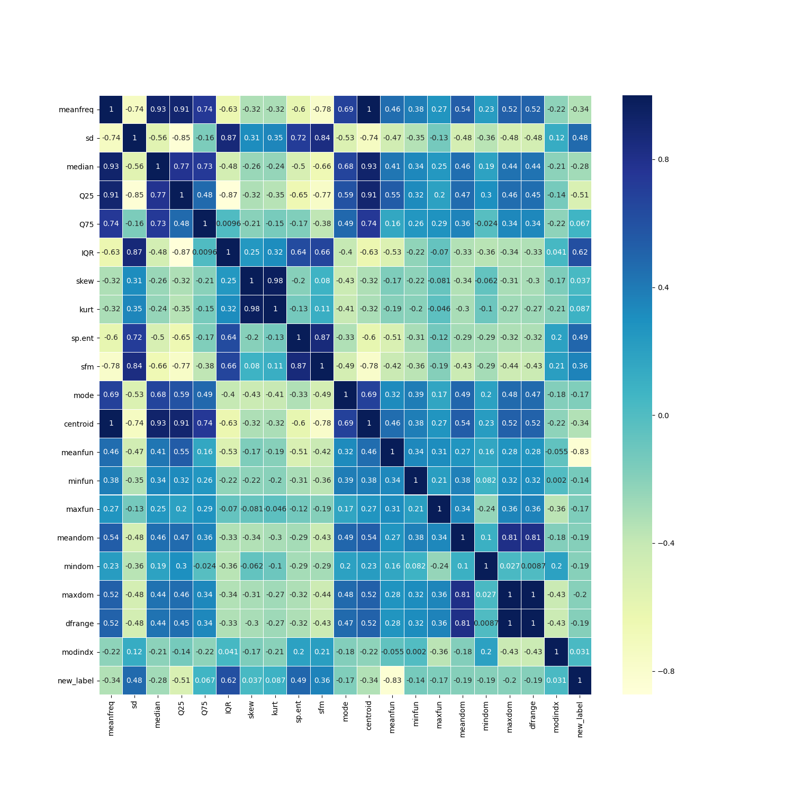
Data Exploration
Heatmap
The heatmap shows that there is a high correlation in the data and multicollinearity can be a problem while analysing the data.
Heatmap

Slide 7
Data Modeling
To classify the data, Logistic Regression model is fitted on the training data set and cross validated. The model is tested on a testing data set.

Slide 8
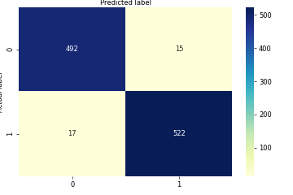
Data Modeling
Logistic regression model
Confusion Matrix
Confusion Matrix

Slide 9
Model Evaluation Metrics
Evaluation Metrics
 | Accuracy | Precision | Recall | F1 Score
Logistic Regression | 96.94 | 97.12 | 96.85 | 96.94

Slide 10
Conclusion
The Logistic Regression model gave the Accuracy of 96.94% with F1 Score 96.94%.

Slide 11
Future Exploration
I would like to extend the project to apply different classification models on the data for example Decision Tree, Random Forest and Support Vector Machine to find the best model for this problem.

Slide 12
Thank You

